Slide 1
3. Array and String Handling

Slide 2
Contents
Array basics, String Array, String class
StringBuffer and StringBuilder class
String Tokenizer Class and Object Class

Slide 3
Arrays in Java
An array is a group of like-typed variables that are referred to by a common name.
Since arrays are objects in Java, we can find their length using member length.
A Java array variable can also be declared like other variables with [] after the data type.
The variables in the array are ordered and each have an index beginning from 0.
Java array can be also be used as a static field, a local variable or a method parameter.
The size of an array must be specified by an int value and not long or short.
The direct superclass of an array type is Object.
Every array type implements the interfaces Cloneable and java.io.Serializable.

Slide 4
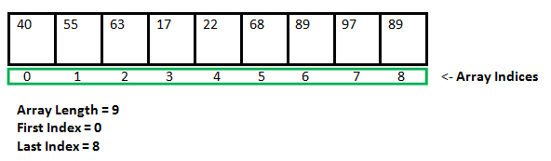
One-Dimensional Arrays :
type var-name[]; OR type[] var-name;
var-name = new type [size]; //memory allocation
int intArray[]; //declaring array
intArray = new int[20]; // allocating memory to array

Slide 5
Declaration:
int[] a;
String difficultWords[];
int temps[];
String[] difficultWords;
int[] temps;
Initialization:
int[] a=new int[100];
Default initialization:
int array----0’s
boolean array---false
Array of objects---null

Slide 6
Accessing Java Array Elements using for Loop
For-each loop in Java
//Show example
for (int i = 0; i < arr.length; i++)
System.out.println("Element at index " + i +" : "+ arr[i]);
Syntax:
for (type var : array)
{ statements using var; }

Slide 7
Limitations of for-each loop
For-each loops are not appropriate when you want to modify the array
For-each loops do not keep track of index. So we can not obtain array index using For-Each loop
for (int num : numbers)
{
if (num == target)
{
return ???; // do not know the index of num
}
}

Slide 8
Limitations of for-each loop
For-each only iterates forward over the array in single steps.
For-each cannot process two decision making statements at once.
// cannot be converted to a for-each loop
for (int i=numbers.length-1; i>0; i--)
{ System.out.println(numbers[i]); }

Slide 9
Multidimensional Arrays
Multidimensional arrays are arrays of arrays with each element of the array holding the reference of other array.
These are also known as Jagged Arrays.
int[][] intArray = new int[10][20]; //a 2D array or matrix
int[][][] intArray = new int[10][20][10]; //a 3D array

Slide 10
String class
A Java String contains an immutable sequence of Unicode characters.
A Java String is an object of the class java.lang.
String literals are stored in a common pool. This facilitates sharing of storage for strings with the same contents to conserve storage.
String objects allocated via new operator are stored in the heap, and there is no sharing of storage for the same contents.

Slide 11
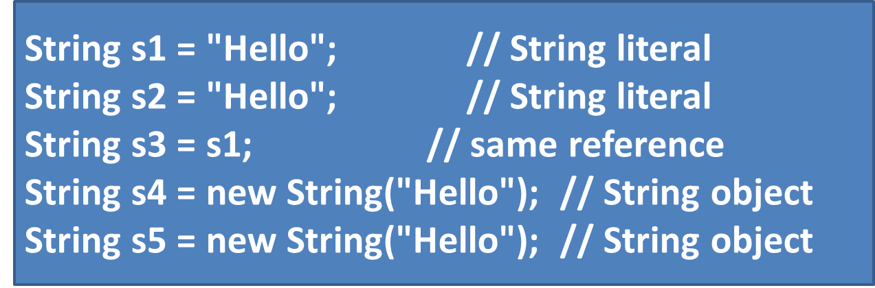
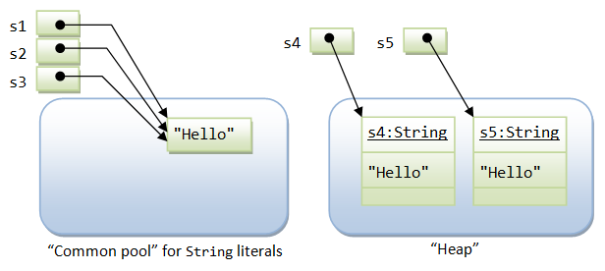
String Literal vs. String Object

Slide 12
When to use ” == “and “equals”
s1 == s1; // true, same pointer
s1 == s2; // true, s1 and s1 share storage in common pool
s1 == s3; // true, s3 is assigned same pointer as s1
s1.equals(s3); // true, same contents
s1 == s4; // false, different pointers
s1.equals(s4); // true, same contents
s4 == s5; // false, different pointers in heap
s4.equals(s5); // true, same contents

Slide 13
String is Immutable
Once a String is constructed, its contents cannot be modified because the other String references sharing the same storage location will be affected by the changes.
If the contents of a String have to be modified frequently, use the StringBuffer or StringBuilder class instead.

Slide 14
Methods of String Class
Method | Example
concat() | s3=s1.concat(s2)
public String substring(int startIndex): public String substring(int startIndex, int endIndex): | String s="hello"; System.out.println(s.substring(0,2));
length() : returns length of string | S1.length();
toUpperCase(), toLowerCase()
trim():-Trims spaces | S1.trim();
startsWith() :-returns true or false endsWith() | s.startsWith(“he")
charAt():-returns char at particular position | s.charAt(0)
replace():-Replaces with other string | replaceString=s1.replace(“hello",“hi")

Slide 15
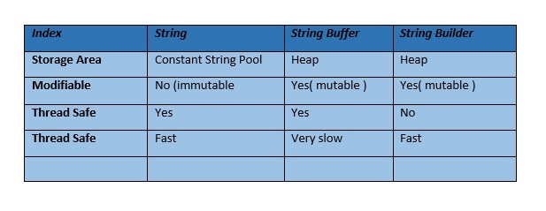
Difference between String,Stringbuffer and stringbuilder

Slide 16
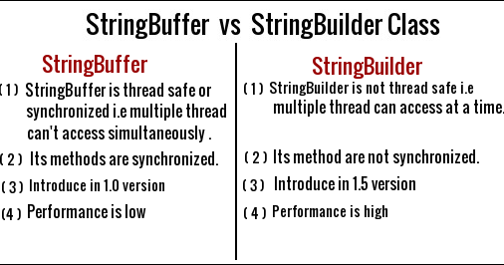

Slide 17
StringBuffer class
Java StringBuffer class is used to create mutable (modifiable) string.
The StringBuffer class in java is same as String class except it is mutable i.e. it can be changed.
String buffers are safe for use by multiple threads.

Slide 18
StringBuffer class
The principal operations on a StringBuffer are the append and insert methods.
Constructor | Description
StringBuffer(). | Constructs a string buffer with no characters in it and an initial capacity of 16 characters
StringBuffer(CharSequence seq) | Constructs a string buffer that contains the same characters as the specified CharSequence.
StringBuffer(int capacity) | Constructs a string buffer with no characters in it and the specified initial capacity.
StringBuffer(String str) | Constructs a string buffer initialized to the contents of the specified string.

Slide 19
StringBuffer Methods
Modifier and Type | Method | Description
public synchronized StringBuffer | append(String s) | is used to append the specified string with this string. The append() method is overloaded like append(char), append(boolean), append(int), append(float), append(double) etc.
public synchronized StringBuffer | insert(int offset, String s) | is used to insert the specified string with this string at the specified position. The insert() method is overloaded like insert(int, char), insert(int, boolean), insert(int, int), insert(int, float), insert(int, double) etc.
public synchronized StringBuffer | replace(int startIndex, int endIndex, String str) | is used to replace the string from specified startIndex and endIndex.
public synchronized StringBuffer | delete(int startIndex, int endIndex) | is used to delete the string from specified startIndex and endIndex.
public synchronized StringBuffer | reverse() | is used to reverse the string.

Slide 20
public int | capacity() | is used to return the current capacity.
public void | ensureCapacity(int minimumCapacity) | is used to ensure the capacity at least equal to the given minimum.
public char | charAt(int index) | is used to return the character at the specified position.
public int | length() | is used to return the length of the string i.e. total number of characters.
public String | substring(int beginIndex) | is used to return the substring from the specified beginIndex.
public String | substring(int beginIndex, int endIndex) | is used to return the substring from the specified beginIndex and endIndex.

Slide 21
StringBuffer capacity() method
The capacity() method of StringBuffer class returns the current capacity of the buffer.
The default capacity of the buffer is 16.
If the number of character increases from its current capacity, it increases the capacity by (oldcapacity*2)+2.
For example if your current capacity is 16, it will be (16*2)+2=34.
//show examples

Slide 22
Java StringBuilder Class
A mutable sequence of characters.
This class provides an API compatible with StringBuffer, but with no guarantee of synchronization.
Constructor and Description | Description
StringBuilder() | Constructs a string builder with no characters in it and an initial capacity of 16 characters.
StringBuilder(CharSequence seq) | Constructs a string builder that contains the same characters as the specified CharSequence.
StringBuilder(int capacity) | Constructs a string builder with no characters in it and an initial capacity specified by the capacity argument.
StringBuilder(String str) | Constructs a string builder initialized to the contents of the specified string.

Slide 23
Methods
Method | Description
public StringBuilder append(String s) | is used to append the specified string with this string. The append() method is overloaded like append(char), append(boolean), append(int), append(float), append(double) etc.
public StringBuilder insert(int offset, String s) | is used to insert the specified string with this string at the specified position. The insert() method is overloaded like insert(int, char), insert(int, boolean), insert(int, int), insert(int, float), insert(int, double) etc.
public StringBuilder replace(int startIndex, int endIndex, String str) | is used to replace the string from specified startIndex and endIndex.
public StringBuilder delete(int startIndex, int endIndex) | is used to delete the string from specified startIndex and endIndex.
public StringBuilder reverse() | is used to reverse the string.

Slide 24
//show compare.java
public int capacity() | is used to return the current capacity.
public void ensureCapacity(int minimumCapacity) | is used to ensure the capacity at least equal to the given minimum.
public char charAt(int index) | is used to return the character at the specified position.
public int length() | is used to return the length of the string i.e. total number of characters.
public String substring(int beginIndex) | is used to return the substring from the specified beginIndex.
public String substring(int beginIndex, int endIndex) | is used to return the substring from the specified beginIndex and endIndex.

Slide 25
Java toString() method
Object class contains toString() method.
used to get string representation of an object.
Recommended to override tostring() method.
//show printobject.java

Slide 26
String Tokenizer
The string tokenizer class allows an application to break a string into tokens.
The StringTokenizer methods do not distinguish among identifiers, numbers, and quoted strings, nor do they recognize and skip comments.
The set of delimiters (the characters that separate tokens) may be specified either at creation time or on a per-token basis.

Slide 27
StringTokenizer st = new StringTokenizer("this is a test");
while (st.hasMoreTokens()) {
System.out.println(st.nextToken());
}
Output:
This
is
a
test

Slide 28
Constructors
Construtor | Description
StringTokenizer(String str) | Constructs a string tokenizer for the specified string.
StringTokenizer(String str, String delim) | Constructs a string tokenizer for the specified string.
StringTokenizer(String str, String delim, boolean returnDelims) | Constructs a string tokenizer for the specified string. If return value is true, delimiter characters are considered to be tokens. If it is false, delimiter characters serve to separate tokens.

Slide 29
Methods of StringTokenizer
Public method | Description
boolean hasMoreTokens() | checks if there is more tokens available.
String nextToken() | returns the next token from the StringTokenizer object.
String nextToken(String delim) | returns the next token based on the delimeter.
boolean hasMoreElements() | same as hasMoreTokens() method.
Object nextElement() | same as nextToken() but its return type is Object.
int countTokens() | returns the total number of tokens.

Slide 30
Object class
Class Object is the root of the class hierarchy. Every class has Object as a superclass.
The Object class is beneficial if you want to refer any object whose type you don't know.
//show example objecttest.java

Slide 31
Methods
Method | Description
public final Class getClass() | returns the Class class object of this object. The Class class can further be used to get the metadata of this class.
public int hashCode() | returns the hashcode number for this object.
public boolean equals(Object obj) | compares the given object to this object.
public String toString() | returns the string representation of this object.
protected void finalize()throws Throwable | is invoked by the garbage collector before object is being garbage collected.

Slide 32
Finalize method
This method is called just before an object is garbage collected.
It is called by the Garbage Collector on an object when garbage collector determines that there are no more references to the object.
We should override finalize() method to dispose system resources, perform clean-up activities and minimize memory leaks.
//show objectgc.java

Slide 33
//substringcons..java
//StringDemo.java

